Slide 1

Understanding Happiness
Rufus Stewart, Psychologist
THE HAPPINESS SCIENCE SERIES

Slide 2

Highlights and Insights
Topics of this Presentation
Definition of Happiness
Happiness and Money
Happiness and Social Connections
The Traits of Happy People

Slide 3

My name is Rufus Stewart
Who am I?
PSYCHOLOGIST
Presentations are communication tools that can be demonstrations.
ETERNAL OPTIMIST
Presentations are communication tools that can be demonstrations.

Slide 4

On a scale of 1 to 10, how happy are you?
ABSOLUTELY NO RIGHT
OR WRONG ANSWERS!

Slide 5
The Results
98%
OF THE WORLD POPULATION RATED THEMSELVES 9 ON THE HAPPINESS SCALE
Presentations are tools that can be lectures..

Slide 6

What is happiness?
Presentations are communication tools that can be demonstrations.
Simply put, a life lived in virtue

Slide 7
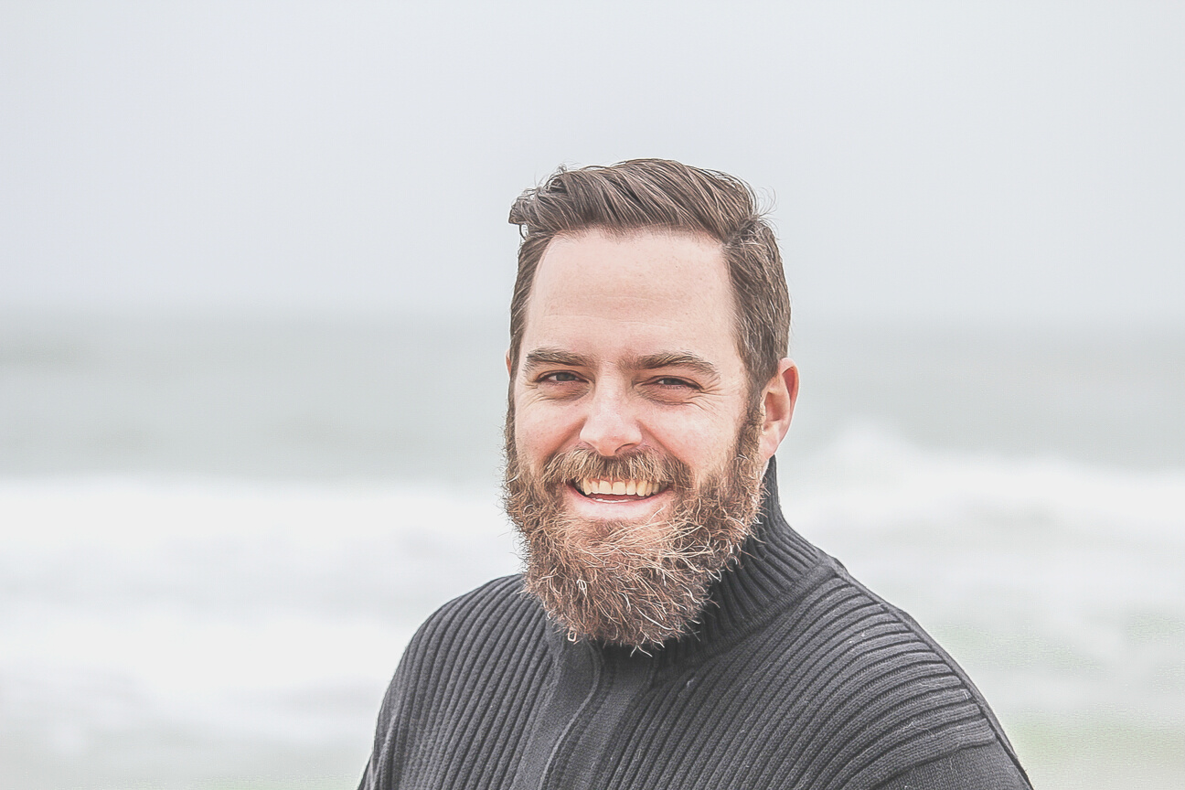
How do people define happiness?
ARISTOTLE
Presentations are communication tools that can be demonstrations, lectures, reports, and more.
Philosopher

Slide 8

How do people define happiness?
BERTRAND RUSSELL
Presentations are communication tools that can be demonstrations, lectures, reports, and more.
Nobel Laureate

Slide 9

How do people define happiness?
ABRAHAM MASLOW
Presentations are communication tools that can be demonstrations, lectures, reports, and more.
Psychologist

Slide 10
40
The Global Happiness Index
30
20
Presentations are tools that can be demonstrations, lectures, reports, and more.
10
0
Item 1
Item 2
Item 3
Item 4
Item 5

Slide 11

Presentations are tools that can be demonstrations, lectures, reports, and more.
Money does buy happiness!
Happiness
and Money

Slide 12

Presentations are tools that can be lectures, reports,
and more.

Slide 13
GIVES PURPOSE IN ONE'S LIFE
Presentations are tools that can be lectures.
HAVING FRIENDS IS GOOD
FOR THE SOUL
Presentations are tools that can be lectures.
MAN IS NOT MADE TO LIVE ALONE
Presentations are tools that can be lectures.
Happiness
and Social Connections
PRESENCE OF OTHER PEOPLE ENHANCES ONE'S QUALITY OF LIFE
Presentations are tools that can be lectures.

Slide 14



The Portraits of Happy People
Presentations are tools that can be lectures, reports, and more.

Slide 15

Happiness Apps
and Websites
Presentations are tools that can be lectures, reports, and more.
Popular sources
of happy inspiration

Slide 16




The Traits of Happy People
Observe and practice these for yourself
They are hopeful
They approach life with zest
They are grateful
They are authentic

Slide 17


Happiness is determined by success in life
Happiness is determined by kindness and compassion

Slide 18

Presentations are tools that can be demonstrations, lectures, reports, and more.
Conducted in June of 2019
The Happiness Experiment

Slide 19



Steps
of the Experiment
PARTICIPANTS WERE MADE TO WEAR EEG SENSORS.
PARTICIPANTS WERE MADE TO WATCH FIVE VIDEOS.
EEG SENSOR RESULTS WERE RECORDED AND ANALYZED.

Slide 20


1 of 5 videos shown to participants
Presentations are tools that can be lectures, reports, and more.

Slide 21
The Results of the Experiment
BEFORE VIDEOS WERE VIEWED
VIEWING OF VIDEOS (BEFORE EMOTIONAL RESPONSE)
VIEWING OF VIDEOS (AFTER EMOTIONAL RESPONSE)
Presentations are tools that can be lectures.
Presentations are tools that can be lectures.
Presentations are tools that can be lectures.

Slide 22
Trends and patterns
Themes of
the Results
40
Presentations are tools that can be demonstrations, lectures, reports, and more.
30
20
10
0
Item 1
Item 2
Item 3
Item 4

Slide 23
PEOPLE'S HAPPINESS WERE TRIGGERED
BY SIMPLE THINGS.
Presentations are tools that can be lectures.
ANIMALS AND BABIES ARE POPULAR HAPPINESS TRIGGERS.
Analysis of Results
Presentations are tools that can be lectures.
PEOPLE'S HAPPINESS IS LARGELY EQUATED WITH FINANCIAL STABILITY.
Presentations are tools that can be lectures.

Slide 24


8 out of 10
EQUATED HAPPINESS TO BEING KIND TO OTHERS
9 out of 10
EQUATED HAPPINESS TO CONTENTMENT IN LIFE

Slide 25
DO NOT POSTPONE YOUR HAPPINESS.
NEVER UNDERESTIMATE YOUR RESILIENCE.
SPEND MONEY ON WONDERFUL EXPERIENCES.
Presentations are tools that can be lectures.
Presentations are tools that can be lectures.
Presentations are tools that can be lectures.
Useful Everyday Tips

Slide 26
DO RANDOM ACTS
OF KINDNESS
VOLUNTEER AND HELP OTHERS
KEEP A GRATITUDE JOURNAL
Presentations are tools that can be lectures.
Presentations are tools that can be lectures.
Presentations are tools that can be lectures.
FORGIVE QUICKLY, BUT WITH MEANING
EXERCISE MINDFULNESS
BE COMPASSIONATE & UNDERSTANDING
Presentations are tools that can be lectures.
Presentations are tools that can be lectures.
Presentations are tools that can be lectures.

Slide 27

Final Words
The most simple things can bring the most happiness.
IZABELLA SCORUPCO

